Slide 1
Working with Windows and DOS Systems
Chapter 7

Slide 2
Objectives
Explain the purpose and structure of file systems
Describe Microsoft file structures
Explain the structure of New Technology File System (NTFS) disks
List some options for decrypting drives encrypted with whole disk encryption

Slide 3
Objectives (continued)
Explain how the Windows Registry works
Describe Microsoft startup tasks
Describe MS-DOS startup tasks
Explain the purpose of a virtual machine

Slide 4
Understanding File Systems

Slide 5
Understanding File Systems
File system
Gives OS a road map to data on a disk
Type of file system an OS uses determines how data is stored on the disk
A file system is usually directly related to an OS
When you need to access a suspect’s computer to acquire or inspect data
You should be familiar with the computer’s platform

Slide 6
Understanding the Boot Sequence
Complementary Metal Oxide Semiconductor (CMOS)
Computer stores system configuration and date and time information in the CMOS
When power to the system is off
Basic Input/Output System (BIOS)
Contains programs that perform input and output at the hardware level
Notes:
To ensure that you don’t alter or contaminate data on a suspect’s windows or DOS PC, you must know to access and modify a CMOS.

Slide 7
Understanding the Boot Sequence
When you turn on your computer, the BIOS does several things. This is its usual sequence:
Check the CMOS Setup for custom settings
Load the interrupt handlers and device drivers
Initialize registers and power management
Determine which devices are bootable
Display system settings
Perform the power-on self-test (POST)
Initiate the bootstrap sequence

Slide 8
Understanding the Boot Sequence (continued)
Bootstrap process
Contained in ROM, tells the computer how to proceed
Displays the key or keys you press to open the CMOS setup screen
Could be Delete, F2, F10, Ctrl+Alt+Insert, Ctrl+A, Ctrl+S, Ctrl+F1, or something else
CMOS should be modified to boot from a forensic floppy disk or CD

Slide 9
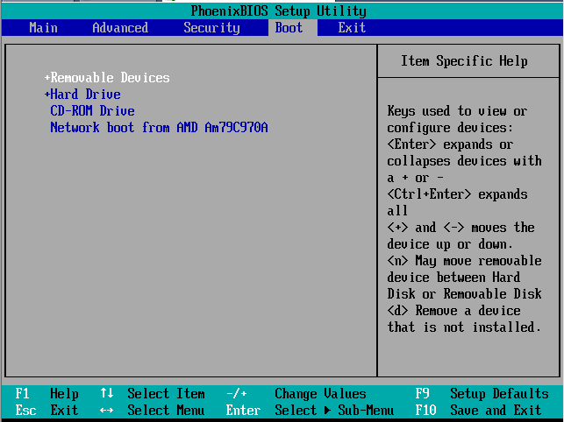
BIOS Setup Utility

Slide 10
Understanding Disk Drives
Disk drives are made up of one or more platters coated with magnetic material.
Disk drive components:
Geometry - refers to the disk’s structure of platters, tracks and sectors
Head - is the device that reads and writes data to a drive. There’s one head per platter
Tracks - are concentric circles on a disk platter where data is located
Cylinders - a cylinder is a column of tracks on two or more disk platters. Typically, each platter has two surfaces: top and bottom
Sectors - a sector is a section on a track, Holds 512 bytes (you cannot read or write anything less than a sector)
Notes:
Geometry – refers to the disk’s structure of platters, tracks and sectors
Head – is the device that reads and writes data to a drive. There’s one head per platter
Tracks – are concentric circles on a disk platter where data is located
Cylinders – a cylinder is a column of tracks on two or more disk platters. Typically, each platter has two surfaces: top and bottom
Sectors – a sector is a section on a track, usually made up of 512 bytes

Slide 11
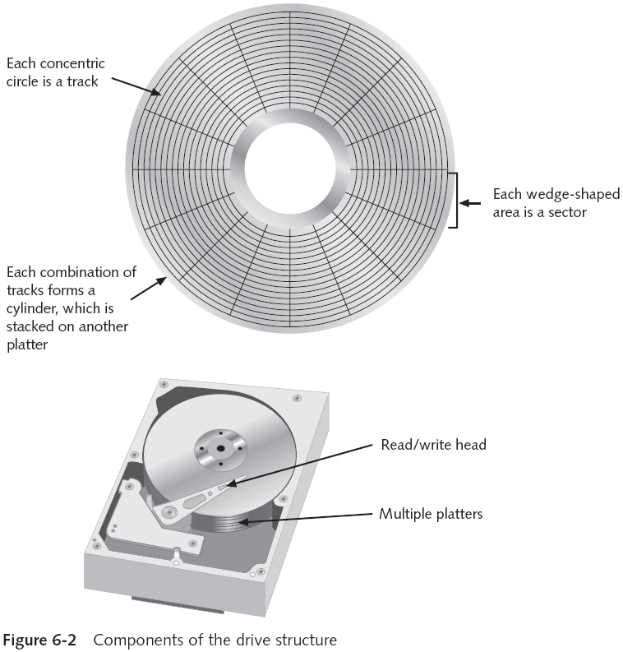

Slide 12
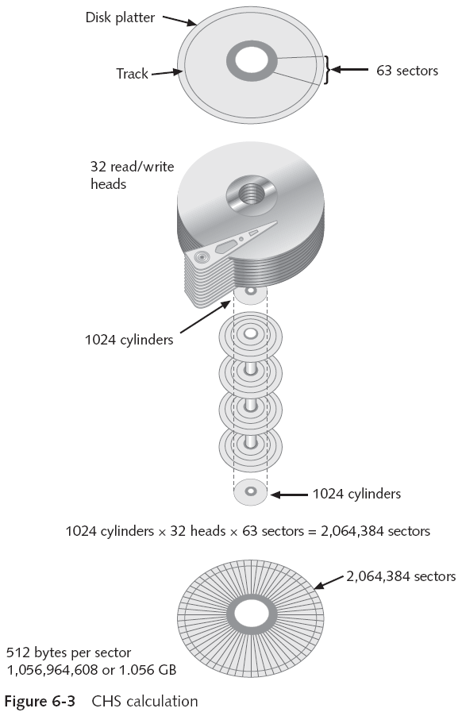
Tracks following numbering scheme starting from 0
E.g.: if the disk lists 79 tracks, you actually have 80 tracks from 0 to 79

Slide 13
Understanding Disk Drives (continued)
Properties handled at the drive’s hardware or firmware level
Zoned bit recording (ZBR) – is how most of manufacturers deal with a platter’s inner tracks being shorter than its outer tracks. Grouping tracks by zones ensures all tracks hold the same amount of data.
Track density - is the space between each track (the smaller the space between each track, the more tracks you can place on the platter.
Areal density - refers to the number of bits in one square inch of a disk platter. This number incudes the unused space between tracks.
Head and cylinder skew - use to improve disk performance
Notes:
ZBR – is how most of manufacturers deal with a platter’s inner tracks being shorter than its outer tracks. Grouping tracks by zones ensures all tracks hold the same amount of data.
Track density – is the space between each track (the smaller the space between each track, the more tracks you can place on the platter.
Areal density – refers to the number of bits in one square inch of a disk platter. This number incudes the unused space between tracks.
Head and cylinder skew – use to improve disk performance

Slide 14
No Need for Multi-Path Erasure
On older disks, the space between tracks was wider, which allowed heads to wander
This made it possible for specialists to retrieve data from previous writes to a platter, even after erasure
Using an electron microscope
On any IDE or SATA or later hard drive, this is impossible
A single pass of zeroes erases all data on a disk so it cannot be recovered by any currently known technique

Slide 15
Exploring Microsoft File Structures

Slide 16
Exploring Microsoft File Structures
In Microsoft file structures, sectors are grouped to form clusters
Storage allocation units of one or more sectors
Clusters are typically 512, 1024, 2048, 4096, or more bytes each
Combining sectors minimizes the overhead of writing or reading files to a disk

Slide 17
Exploring Microsoft File Structures (continued)
Clusters are numbered sequentially starting at 2
First sector of all disks contains a system area, the boot record, and a file structure database
OS assigns these cluster numbers, called logical addresses
Sector numbers are called physical addresses
Clusters and their addresses are specific to a logical disk drive, which is a disk partition

Slide 18
Disk Partitions
A partition is a logical drive
FAT16 does not recognize disks larger than 2 GB
Large disks have to be partitioned
Hidden partitions or voids
Large unused gaps between partitions on a disk
Partition gap
Unused space between partitions

Slide 19
Disk Partitions (continued)
Disk editor utility can alter information in partition table
To hide a partition
Can examine a partition’s physical level with a disk editor:
HxD, Norton DiskEdit, WinHex, or Hex Workshop
Analyze the key hexadecimal codes the OS uses to identify and maintain the file system

Slide 20
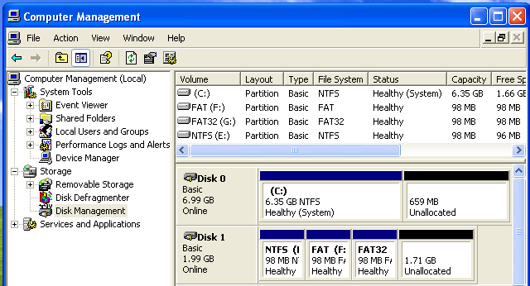
Demo: VM with Three Partitions
Partition Types
NTFS: 07
FAT: 06
FAT32: 0B

Slide 21
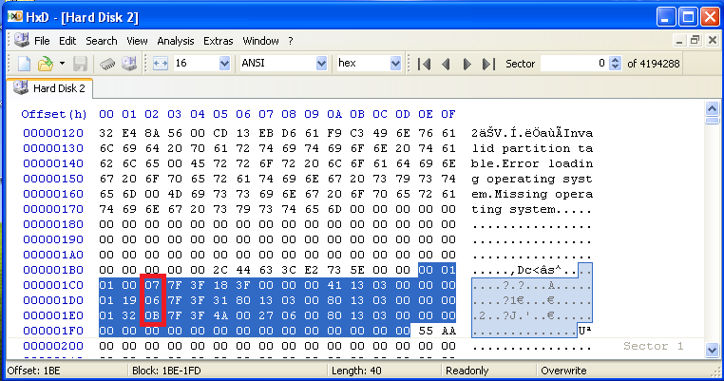
Viewing the Partition Table HxD
Start HxD, Extras, Open Disk, choose Physical Disk
Partition Table starts at 0x1BE
Partition Type field is at offset 0x04 in each record
Notes:
Offset is the number of bytes from the beginning of the string

Slide 22
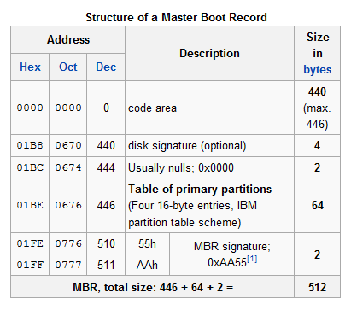
Master Boot Record Structure
From Wikipedia

Slide 23
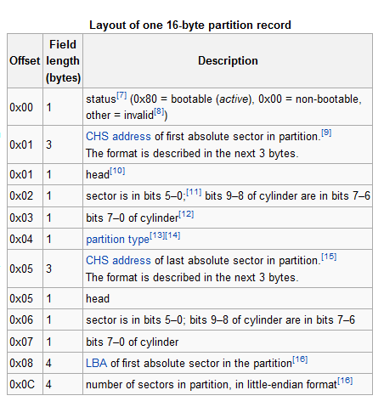
Partition Table Structure
From Wikipedia

Slide 24
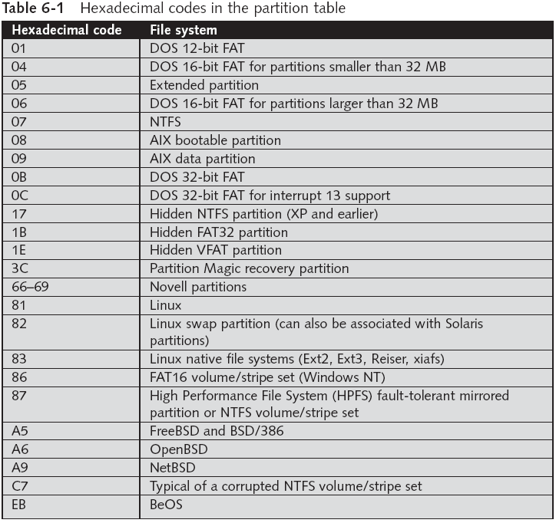

Slide 25
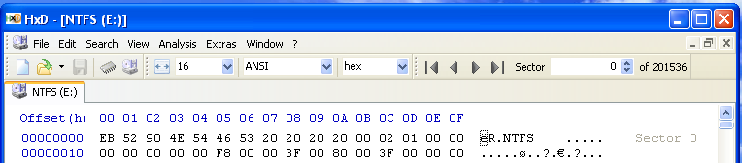
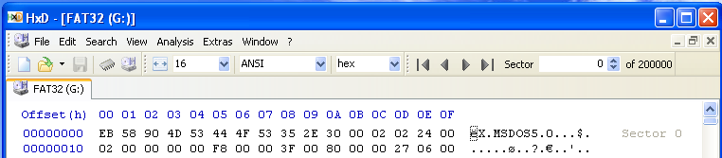
Partition Mark at Start of Volume
Start HxD, Extras, Open Disk
NTFS
FAT32

Slide 26
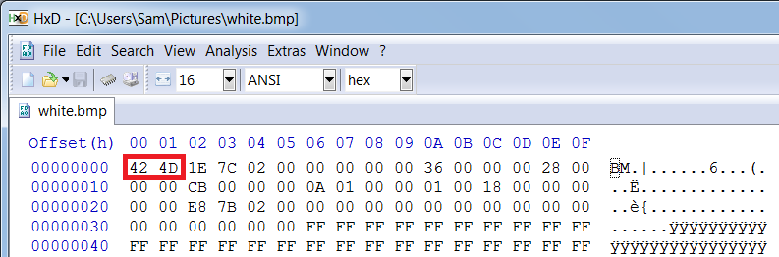
BMP File in HxD
Start HxD, File, Open
BM at start indicates a BMP file

Slide 27
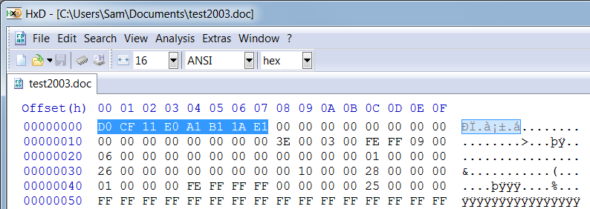
Word Doc File in HxD
Start HxD, File, Open
Word 2003 Format uses these 7 bytes
.docx format is actually a Zip archive

Slide 28
Master Boot Record
On Windows and DOS computer systems
Boot disk contains a file called the Master Boot Record (MBR)
MBR stores information about partitions on a disk and their locations, size, and other important items
Several software products can modify the MBR, such as PartitionMagic’s Boot Magic

Slide 29
Examining FAT Disks
File Allocation Table (FAT)
File structure database that Microsoft originally designed for floppy disks
Used before Windows NT and 2000
FAT database is typically written to a disk’s outermost track and contains:
Filenames, directory names, date and time stamps, the starting cluster number, and file attributes
FAT versions
FAT12, FAT16, FAT32, FATX (for Xbox), and VFAT

Slide 30
FAT Versions
FAT12—for floppy disks, max size 16 MB
FAT16—allows hard disk sizes up to 2 GB
FAT32— allows hard disk sizes up to 2 TB
FATX—For Xbox media
The date stamps start at the year 2000, unlike the other FAT formats that start at 1980
VFAT (Virtual File Allocation Table)
Allows long file names on Windows (MS-DOS had 8.3 limitation)

Slide 31
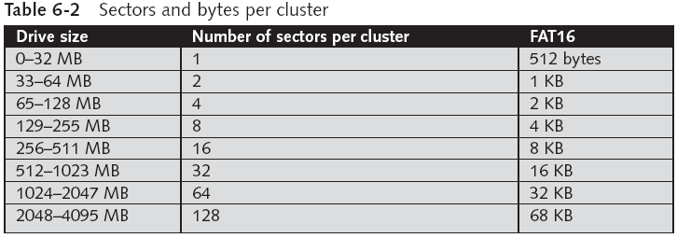
Examining FAT Disks (continued)
Cluster sizes vary according to the hard disk size and file system
This table is for FAT-16

Slide 32
Examining FAT Disks (continued)
Microsoft OSs allocate disk space for files by clusters
Results in drive slack
Unused space in a cluster between the end of an active file and the end of the cluster
Drive slack includes:
RAM slack and file slack
An unintentional side effect of FAT16 having large clusters was that it reduced fragmentation
As cluster size increased

Slide 33
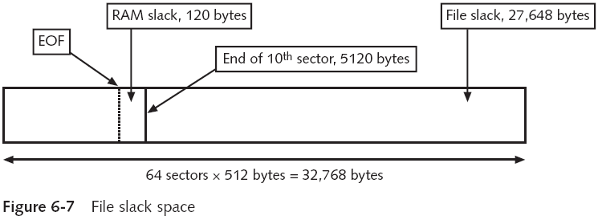
Examining FAT Disks (continued)
Notes:
RAM slack is the slack between the end of the logical file and the rest of that sector. To put it another way RAM slack is the slack at the byte and sector level.
File Slack is the remaining sectors to the end of the cluster. File slack is the sectors to the cluster level.

Slide 34
Examining FAT Disks (continued)
When you run out of room for an allocated cluster
OS allocates another cluster for your file, which creates more slack space on the disk
As files grow and require more disk space, assigned clusters are chained together
The chain can be broken or fragmented

Slide 35
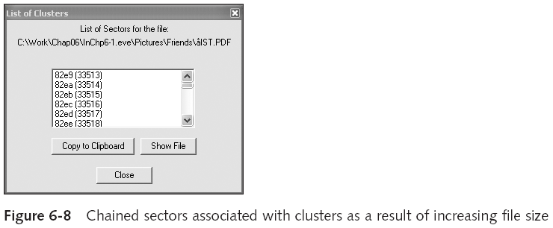
ProDiscover Showing Cluster Chain

Slide 36
Examining FAT Disks (continued)
When the OS stores data in a FAT file system, it assigns a starting cluster position to a file
Data for the file is written to the first sector of the first assigned cluster
When this first assigned cluster is filled and runs out of room
FAT assigns the next available cluster to the file
If the next available cluster isn’t contiguous to the current cluster
File becomes fragmented

Slide 37
Deleting FAT Files
In Microsoft OSs, when a file is deleted
Directory entry is marked as a deleted file
With the HEX E5 (σ) character replacing the first letter of the filename
FAT chain for that file is set to 0
Data in the file remains on the disk drive
Area of the disk where the deleted file resides becomes unallocated disk space
Available to receive new data from newly created files or other files needing more space

Slide 38
Examining NTFS Disks
New Technology File System (NTFS)
Introduced with Windows NT
Recommended file system for Windows 200 Pro, XP, and later versions through Windows 7 at least
Improvements over FAT file systems
NTFS provides more information about a file
NTFS gives more control over files and folders
NTFS was Microsoft’s move toward a journaling file system

Slide 39
Examining NTFS Disks (continued)
In NTFS, everything written to the disk is considered a file
On an NTFS disk
First data set is the Partition Boot Sector
Next is Master File Table (MFT)
NTFS results in much less file slack space
Clusters are smaller for smaller disk drives
NTFS also uses Unicode
An international data format

Slide 40
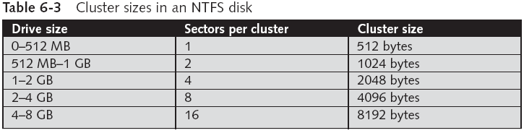
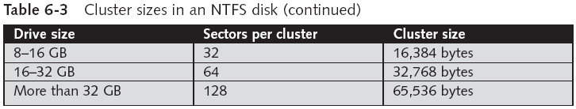
Examining NTFS Disks (continued)

Slide 41
NTFS File System
MFT contains information about all files on the disk
Including the system files the OS uses
In the MFT, the first 15 records are reserved for system files
Records in the MFT are called metadata

Slide 42
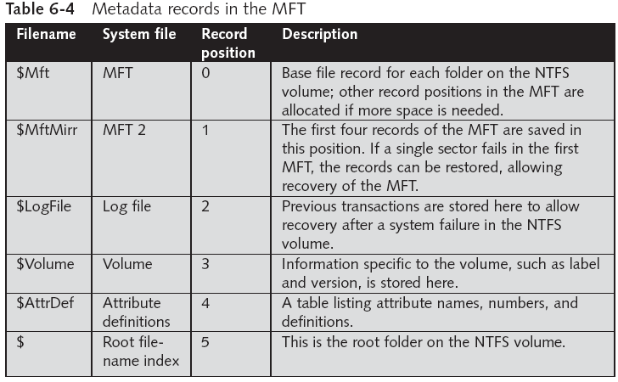
NTFS File System (continued)

Slide 43
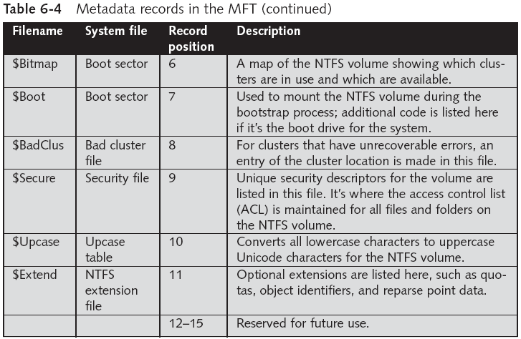
NTFS File System (continued)

Slide 44
MFT and File Attributes
In the NTFS MFT
All files and folders are stored in separate records of 1024 bytes each
Each record contains file or folder information
This information is divided into record fields containing metadata
A record field is referred to as an attribute ID
File or folder information is typically stored in one of two ways in an MFT record:
Resident and nonresident

Slide 45
MFT and File Attributes (continued)
Files larger than 512 bytes are stored outside the MFT
MFT record provides cluster addresses where the file is stored on the drive’s partition
Referred to as data runs
Each MFT record starts with a header identifying it as a resident or nonresident attribute

Slide 46
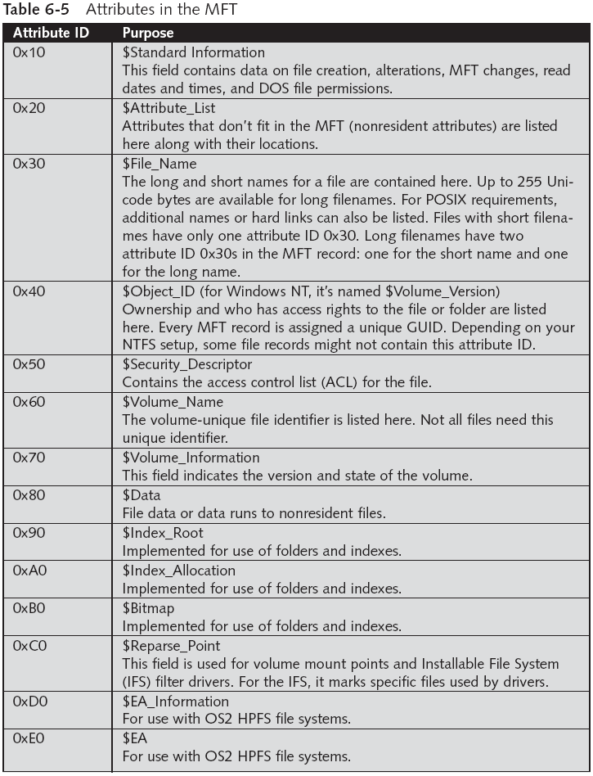

Slide 47
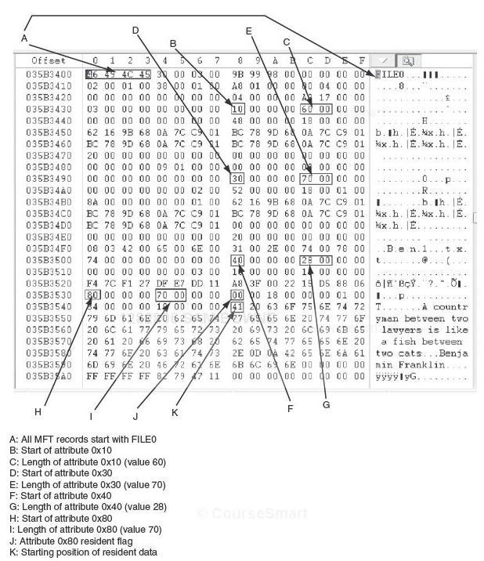
Resident File in a MFT Record

Slide 48
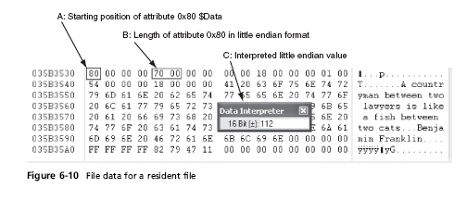
Resident File Data in the MFT
This figure is a repeat of a portion of the previous one

Slide 49
Nonresident File's MFT Record

Slide 50
MFT and File Attributes (continued)
When a disk is created as an NTFS file structure
OS assigns logical clusters to the entire disk partition
These assigned clusters are called logical cluster numbers (LCNs)
Become the addresses that allow the MFT to link to nonresident files on the disk’s partition

Slide 51
NTFS Data Streams
Data streams
Ways data can be appended to existing files
Can obscure valuable evidentiary data, intentionally or by coincidence
In NTFS, a data stream becomes an additional file attribute
Allows the file to be associated with different applications
You can only tell whether a file has a data stream attached by examining that file’s MFT entry

Slide 52
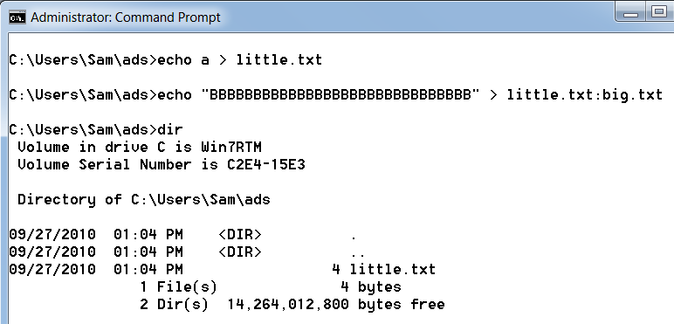
Alternate Data Streams Demonstration

Slide 53
NTFS Compressed Files
NTFS provides compression similar to FAT DriveSpace 3
Under NTFS, files, folders, or entire volumes can be compressed
Most computer forensics tools can uncompressed and analyze compressed Windows data

Slide 54
NTFS Encrypting File System (EFS)
Encrypting File System (EFS)
Introduced with Windows 2000
Implements a public key and private key method of encrypting files, folders, or disk volumes
When EFS is used in Windows 2000
A recovery certificate is generated and sent to the local Windows administrator account
Users can apply EFS to files stored on their local workstations or a remote server

Slide 55
Deleting NTFS Files
When a file is deleted in Windows XP, 2000, or NT
The OS renames it and moves it to the Recycle Bin
Can use the Del (delete) MS-DOS command
Eliminates the file from the MFT listing in the same way FAT does

Slide 56
Understanding Whole Disk Encryption

Slide 57
Understanding Whole Disk Encryption
In recent years, there has been more concern about loss of
Personal identity information (PII) and trade secrets caused by computer theft
Of particular concern is the theft of laptop computers and other handheld devices
To help prevent loss of information, software vendors now provide whole disk encryption

Slide 58
Understanding Whole Disk Encryption (continued)
Current whole disk encryption tools offer the following features:
Preboot authentication (e.g. single sig-on password, fingerprint scan or token)
Full or partial disk encryption with secure hibernation (e.g. activating a password-protected screen saver)
Advanced encryption algorithms (e.g. AES and IDEA)
Key management function (uses a challenge-and-response method to reset passwords or passphrases)
A Trusted Platform Module (TPM) microchip to generate encryption keys and authenticate logins

Slide 59
Understanding Whole Disk Encryption (continued)
Whole disk encryption tools encrypt each sector of a drive separately
Many of these tools encrypt the drive’s boot sector
To prevent any efforts to bypass the secured drive’s partition
To examine an encrypted drive, decrypt it first
Run a vendor-specific program to decrypt the drive

Slide 60
Examining Third-Party Disk Encryption Tools
Some available third-party WDE utilities:
PGP Whole Disk Encryption
Voltage SecureDisk
Utimaco SafeGuard Easy
Jetico BestCrypt Volume Encryption
SoftWinter Sentry 2020 for Windows XP
Some available open-source encryption tools:
TrueCrypt
CrossCrypt
FreeOTFE

Slide 61
Understanding the Windows Registry

Slide 62
Understanding the Windows Registry
Registry
A database that stores hardware and software configuration information, network connections, user preferences, and setup information
For investigative purposes, the Registry can contain valuable evidence
To view the Registry, you can use:
Regedit (Registry Editor) program for Windows 9x systems
Regedt32 for Windows 2000 and XP

Slide 63
Exploring the Organization of the Windows Registry
Registry terminology:
Registry – collection of files containing system and user information
Registry Editor – windows utility for viewing and modifying data in Registry
HKEY – categories of registery
Key – each HKEY contains folders referred as keys. Keys can contain other key folders or values
Subkey – a key displayed under another key

Slide 64
Exploring the Organization of the Windows Registry
Registry terminology:
Branch – a key and its contents
Value – a name and value in the key; its similar to a file and its data content
Default value
Hives – specific branches in HKEY_

Slide 65
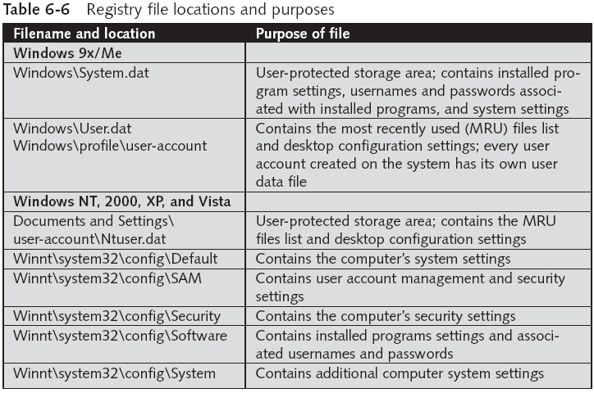
Exploring the Organization of the Windows Registry (continued)

Slide 66
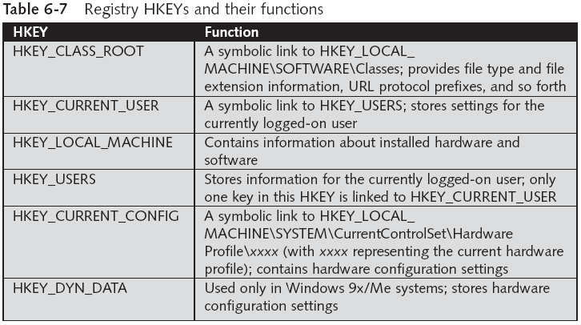
Exploring the Organization of the Windows Registry (continued)

Slide 67
Understanding Microsoft Startup Tasks

Slide 68
Understanding Microsoft Startup Tasks
Learn what files are accessed when Windows starts
This information helps you determine when a suspect’s computer was last accessed
Important with computers that might have been used after an incident was reported

Slide 69
Startup in Windows NT and Later
All Windows NT computers perform the following steps when the computer is turned on:
Power-on self test (POST)
Initial startup
Boot loader
Hardware detection and configuration
Kernel loading
User logon

Slide 70
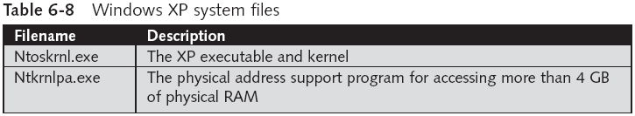
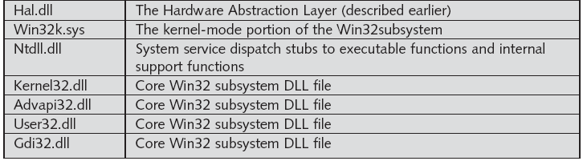
Startup in Windows NT and Later (continued)
Windows XP System Files

Slide 71
Startup in Windows NT and Later (continued)
Contamination Concerns with Windows XP
When you start a Windows XP NTFS workstation, several files are accessed immediately
The last access date and time stamp for the files change to the current date and time
Destroys any potential evidence
That shows when a Windows XP workstation was last used

Slide 72
Understanding MS-DOS Startup Tasks

Slide 73
Understanding MS-DOS Startup Tasks
Two files are used to configure MS-DOS at startup:
Config.sys
A text file containing commands that typically run only at system startup to enhance the computer’s DOS configuration
Autoexec.bat
A batch file containing customized settings for MS-DOS that runs automatically
Io.sys is the first file loaded after the ROM bootstrap loader finds the disk drive

Slide 74
Understanding MS-DOS Startup Tasks (continued)
Msdos.sys is the second program to load into RAM immediately after Io.sys
It looks for the Config.sys file to configure device drivers and other settings
Msdos.sys then loads Command.com
As the loading of Command.com nears completion, Msdos.sys looks for and loads Autoexec.bat

Slide 75
Other Disk Operating Systems
Control Program for Microprocessors (CP/M)
First nonspecific microcomputer OS
Created by Digital Research in 1970
8-inch floppy drives; no support for hard drives
Digital Research Disk Operating System (DR-DOS)
Developed in 1988 to compete with MS-DOS
Used FAT12 and FAT16 and had a richer command environment

Slide 76
Other Disk Operating Systems (continued)
Personal Computer Disk Operating System (PC-DOS)
Created by Microsoft under contract for IBM
PC-DOS works much like MS-DOS

Slide 77
Understanding Virtual Machines

Slide 78
Understanding Virtual Machines
Virtual machine
Allows you to create a representation of another computer on an existing physical computer
A virtual machine is just a few files on your hard drive
Must allocate space to it
A virtual machine recognizes components of the physical machine it’s loaded on
Virtual OS is limited by the physical machine’s OS

Slide 80
Understanding Virtual Machines (continued)
In computer forensics
Virtual machines make it possible to restore a suspect drive on your virtual machine
And run nonstandard software the suspect might have loaded
From a network forensics standpoint, you need to be aware of some potential issues, such as:
A virtual machine used to attack another system or network

Slide 81
Creating a Virtual Machine
Popular applications for creating virtual machines
VMware, Microsoft Virtual PC, Oracle VirtualBox
Using Virtual PC
You must download and install Virtual PC first

Slide 82
Creating a Virtual Machine (continued)

Slide 83
Creating a Virtual Machine (continued)

Slide 84
Creating a Virtual Machine (continued)
You need an ISO image of an OS
Because no OSs are provided with Virtual PC
Virtual PC creates two files for each virtual machine:
A .vhd file, which is the actual virtual hard disk
A .vmc file, which keeps track of configurations you make to that disk
See what type of physical machine your virtual machine thinks it’s running
Open the Virtual PC Console, and click Settings

Slide 85
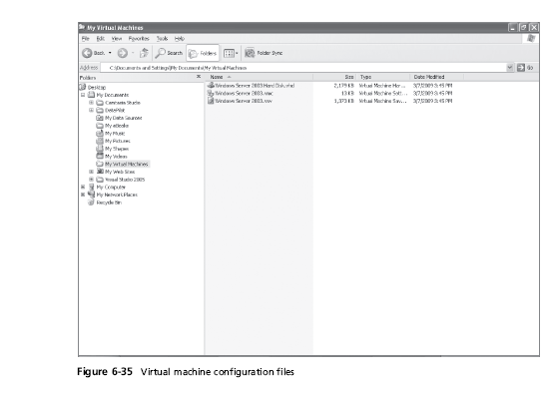
Creating a Virtual Machine (continued)

Slide 86
Creating a Virtual Machine (continued)

Slide 87
Macintosh and Linux Boot Processes and File Systems
Chapter 7

Slide 88
Objectives
Explain Macintosh file structures and the boot process
Explain UNIX and Linux disk structures and boot processes
Describe other disk structures

Slide 89
Understanding the Macintosh File Structure and Boot Process

Slide 90
Understanding the Macintosh File Structure and Boot Process
Mac OS X version 10.5 - Leopard
Darwin core
BSD UNIX application layer

Slide 91
Understanding the Macintosh File Structure and Boot Process
Mac OS 9 & earlier used:
Hierarchical File System (HFS)
Files stored in nested directories (folders)
Extended Format File System (HFS+)
Introduced with Mac OS 8.1
Supports smaller file sizes on larger volumes, resulting in more efficient disk use

Slide 92
Understanding the Macintosh File Structure and Boot Process (continued)
File Manager utility
Reading, writing, and storing data to physical media
Finder
Keeps track of files and maintain users’ desktops
In older Mac OSs, a file consists of two parts:
Data fork and resource fork
Stores file metadata and application information

Slide 93
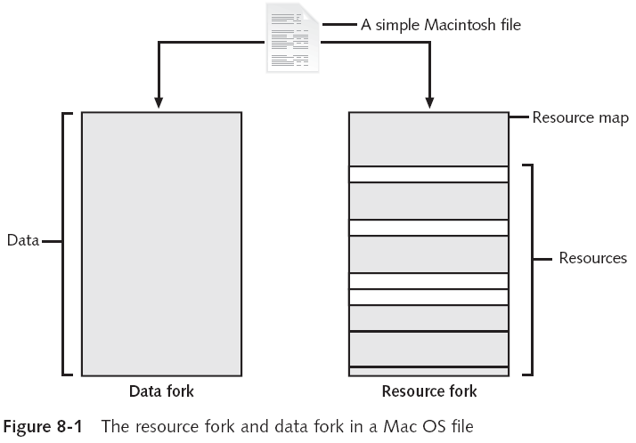

Slide 94
Understanding Macintosh OS 9 Volumes
A volume is any storage medium used to store files
Can be all or part of a hard disk
On a floppy disk is always the entire disk
Allocation and logical blocks
Logical blocks cannot exceed 512 bytes
Allocation blocks are a set of consecutive logical blocks

Slide 95
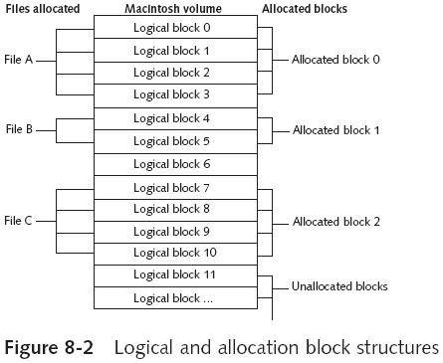
Understanding Macintosh OS 9 Volumes (continued)

Slide 96
Understanding Macintosh OS 9 Volumes (continued)
Two EOF descriptors
Logical EOF
Actual size of the file
Physical EOF
The number of allocation blocks for that file
Clumps
Groups of contiguous allocation blocks
Used to reduce file fragmentation
Volume fragmentation is kept to a minimum by adding more clumps to larger files

Slide 97
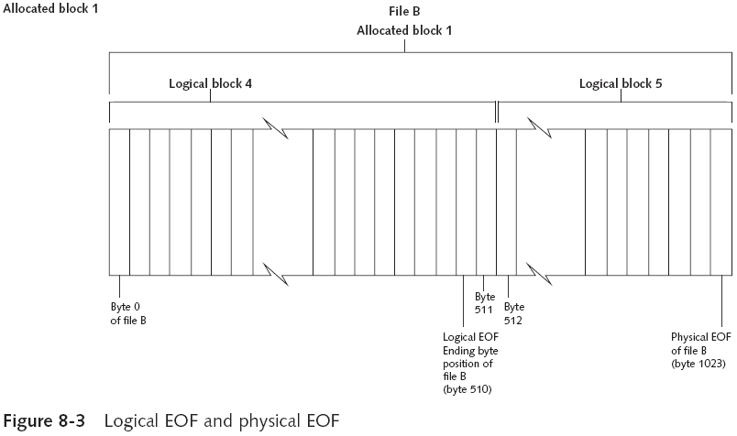
Understanding Macintosh OS 9 Volumes (continued)
Notes:
Logical EOF – actual size of the file
Physical EOF – number of allocation blocks for that file

Slide 98
Exploring Macintosh Boot Tasks
Use Open Firmware instead of BIOS
Processor- and system-independent firmware
Controls microprocessor after hardware initialization
The boot process for OS 9 is as follows:
Power on the computer
Hardware self-test and Open Firmware run
Macintosh OS starts
The startup disk is located
System files are opened
System extensions are loaded
OS 9 Finder starts

Slide 99
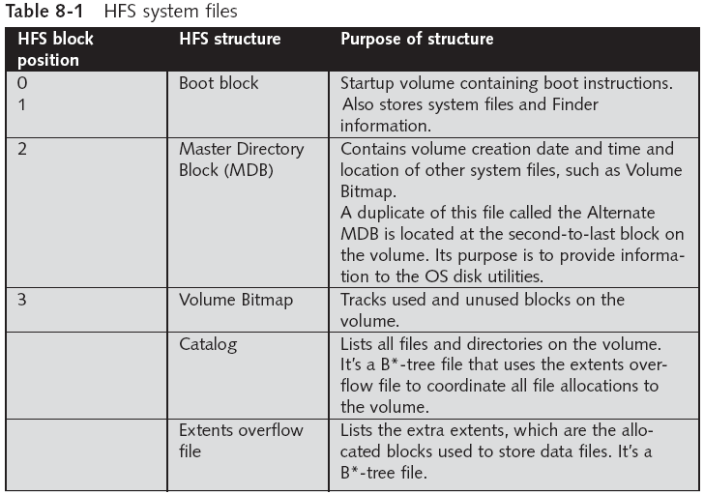

Slide 100
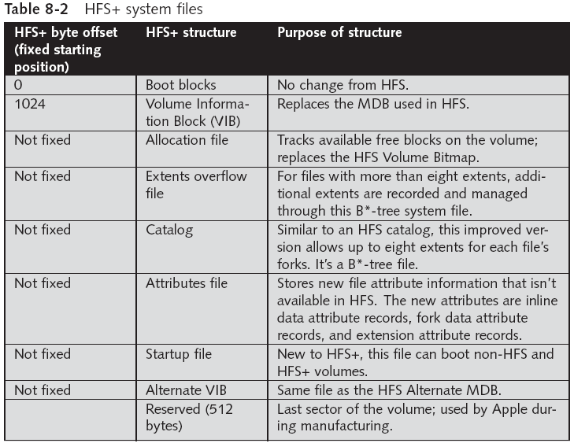

Slide 101
Exploring Macintosh Boot Tasks (continued)
Older Macintosh OSs use
First two logical blocks as boot blocks
Master Directory Block (MDB) or Volume Information Block (VIB)
Stores all information about a volume
Volume Control Block (VCB)
Stores information from the MDB when OS mounts
Extents overflow file
Stores any file information not in the MDB or a VCB

Slide 102
Exploring Macintosh Boot Tasks (continued)
Catalog
Listing of all files and directories on the volume
Maintains relationships between files and directories
Volume Bitmap
Tracks used and unused blocks on a volume
Mac OS 9 uses the B*-tree file system for File Manager
Actual file data is stored on the leaf nodes
B*-tree also uses header, index, and map nodes

Slide 103
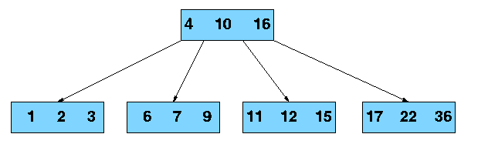
B-Tree
A way of storing records so they can be found rapidly
Each node can only hold a few records, if more are added the node splits and the tree grows taller

Slide 104
Using Macintosh Forensic Software
Tools and vendors
BlackBag Technologies
SubRosaSoft MacForensicsLab
Guidance EnCase
X-Ways Forensics
ProDiscover Forensic Edition
Sleuth Kit and Autopsy

Slide 105
Using Macintosh Forensic Software (continued)
Macintosh Acquisition Methods
Make an image of the drive
Static acquisition of the suspect drive is preferable to a live acquisition
Removing the drive from a Macintosh Mini’s CPU case is difficult
Attempting to do so without Apple factory training could damage the computer
Use a Macintosh-compatible forensic boot CD (or FireWire boot drive) to make an image on an external USB or FireWire drive

Slide 106
Using Macintosh Forensic Software (continued)
Macintosh Acquisition Methods (continued)
BlackBag Technologies sells acquisition products specifically designed for OS 9 and earlier
As well as OS X
MacQuisition is a forensic boot CD that makes an image of a Macintosh drive
After making an acquisition, examine the image of the file system
The tool you use depends on the image file format

Slide 107
Using Macintosh Forensic Software (continued)
Macintosh Acquisition Methods (continued)
BlackBag Technologies Macintosh Forensic Software and SubRosaSoft MacForensicsLab
Can disable/enable Disk Arbitration—which mounts drives
Being able to turn off the mount function in OS X
Allows you to connect a suspect drive to a Macintosh without a write-blocking device

Slide 108
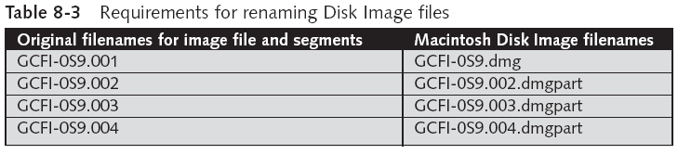
Using Macintosh Forensic Software (continued)
Examining OS 9 Data Structures with BlackBag
Activities in this section assume you have a Macintosh running OS X
All data acquisitions (image files) must be configured as Disk Images
With the correct filename and extensions
To keep the correct order of each segment
Numbers need to be inserted between the filename and the extension

Slide 109
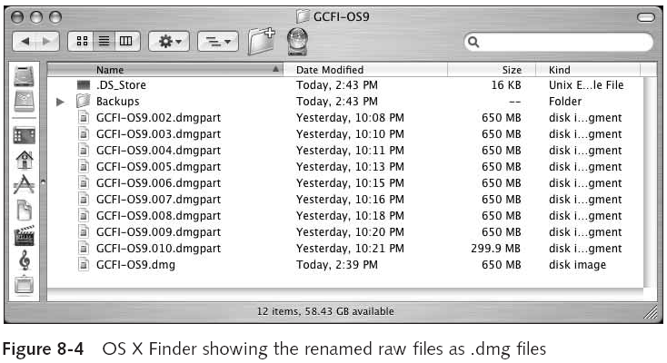
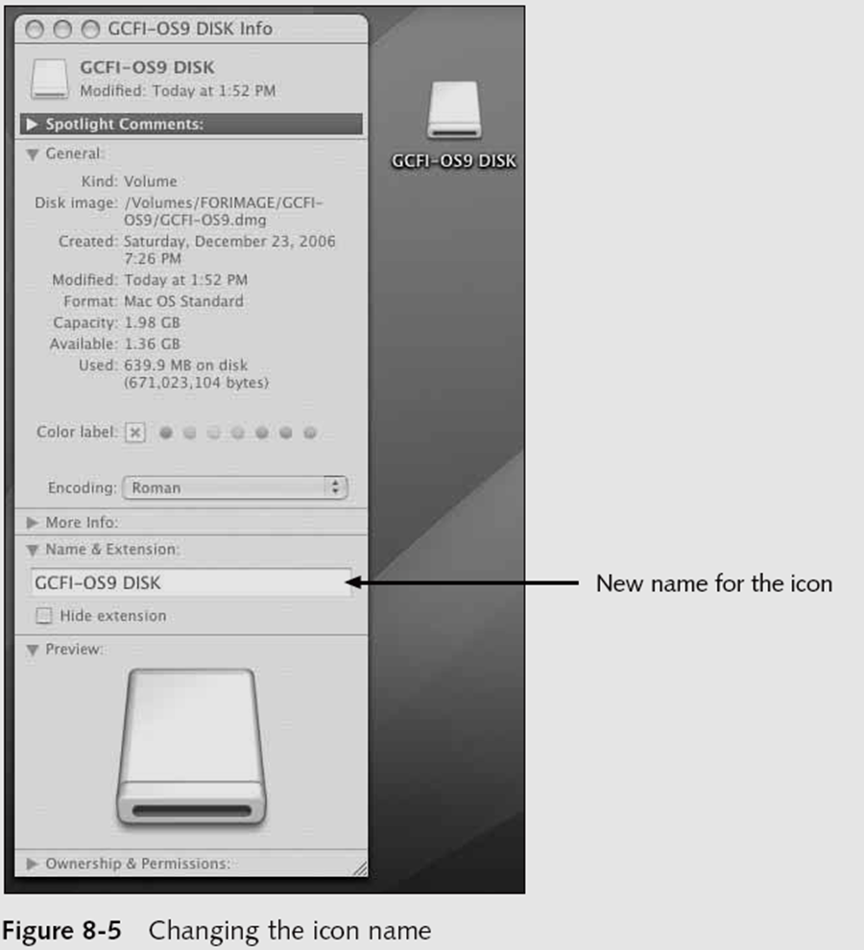
Using Macintosh Forensic Software (continued)
Examining OS 9 Data Structures with BlackBag (continued)
Load images as a virtual disk image double-clicking the files in Finder (Figure 8-4)
OS X loads and displays an icon of the virtual mounted disk with the name “untitled” on the desktop
You can rename it with your case name
See Figure 8-5

Slide 110
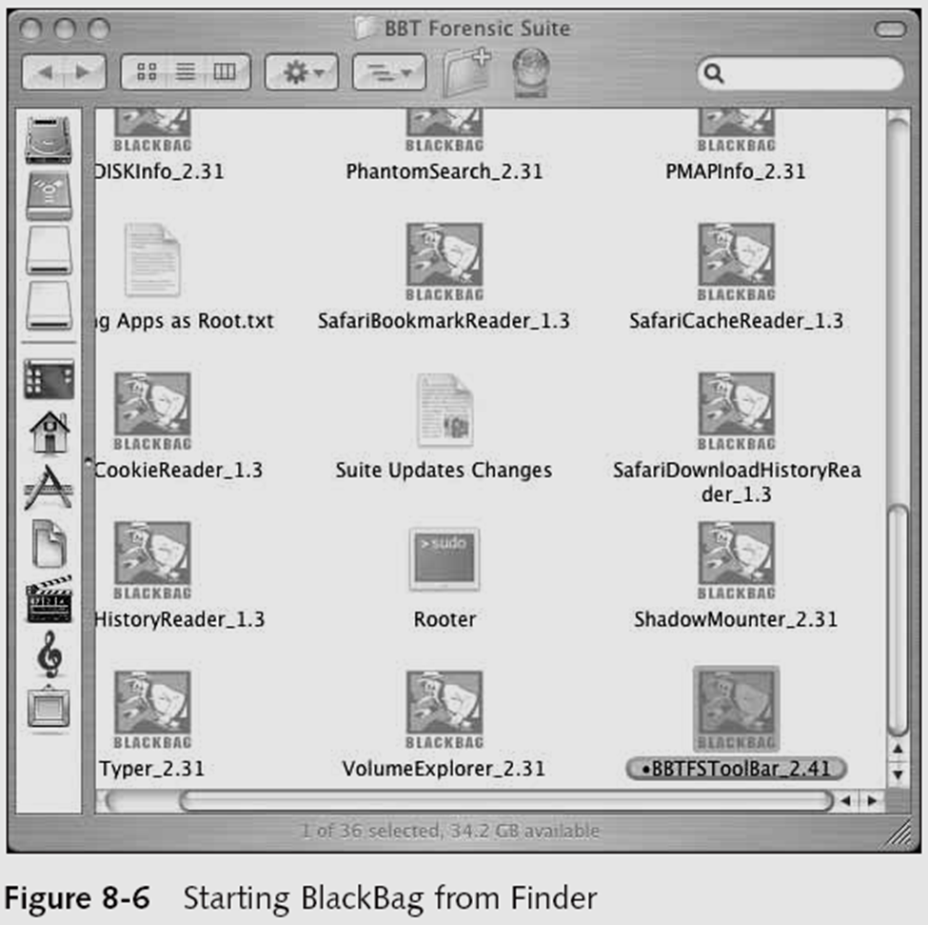
Using Macintosh Forensic Software (continued)
Examining OS 9 Data Structures with BlackBag (continued)
Start BlackBag from Finder
See Figure 8-6
BlackBag includes several utilities for conducting a full analysis of evidence, including
PDISKInfo, PMAPInfo, DirectoryScan, FileSearch, MacCarver, and FileSpy

Slide 111
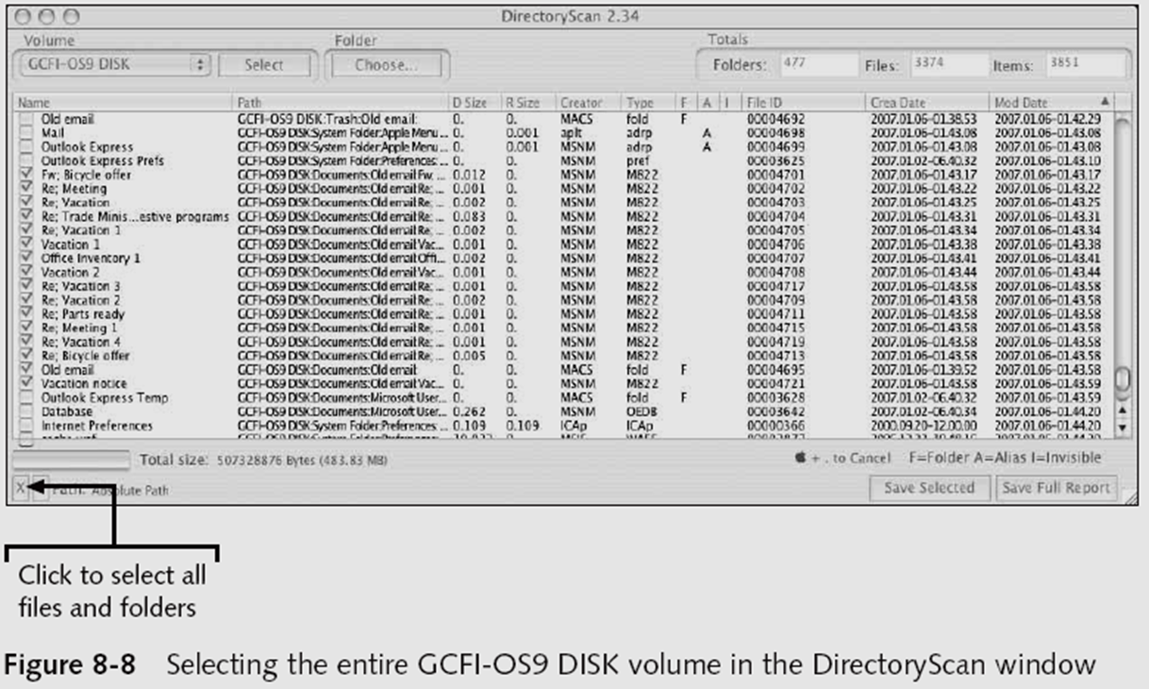
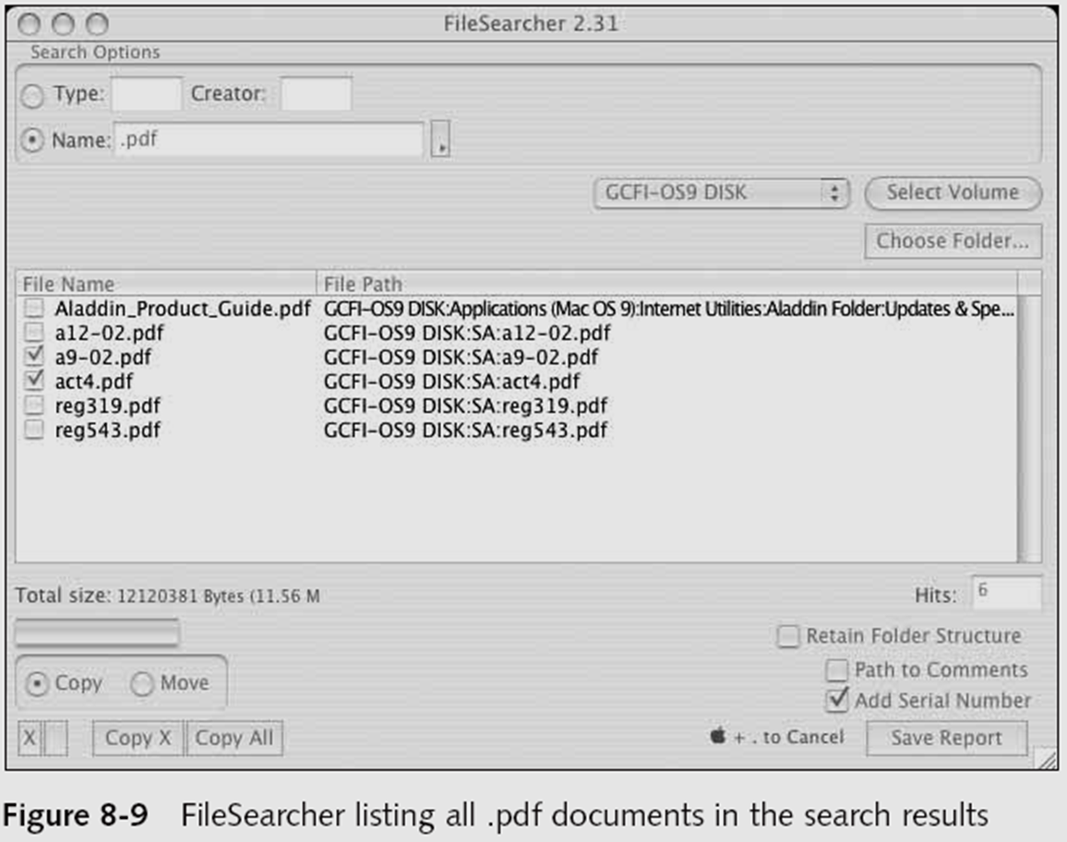
Using Macintosh Forensic Software (continued)
Examining OS 9 Data Structures with BlackBag (continued)
Activity 1:
Use the BlackBag DirectoryScan utility, which lists all folders and files, visible and hidden, in the image loaded as a .dmg file
See Figure 8-8
Activity 2:
Use the FileSearcher utility to locate files by a specific extension
See Figure 8-9

Slide 112
Examining UNIX and Linux Disk Structures and Boot Processes

Slide 113
Examining UNIX and Linux Disk Structures and Boot Processes
UNIX flavors
System V variants, Sun Solaris, IBM AIX, and HP-UX
BSD, FreeBSD, OpenBSD, and NetBSD
Linux distributions
Red Hat, Fedora, Ubuntu, and Debian
Most consistent UNIX-like OSs
Linux kernel is regulated under the GNU General Public License (GPL) agreement

Slide 114
Examining UNIX and Linux Disk Structures and Boot Processes (continued)
BSD license is similar to the GPL
But makes no requirements for derivative works
Some useful Linux commands to find information about your Linux system
uname –a (displays the name of the system)
ls –l (list all files)
ls –ul filename
netstat –s (idvia entifies other systems connected the network to a UNIX or Linux system

Slide 115
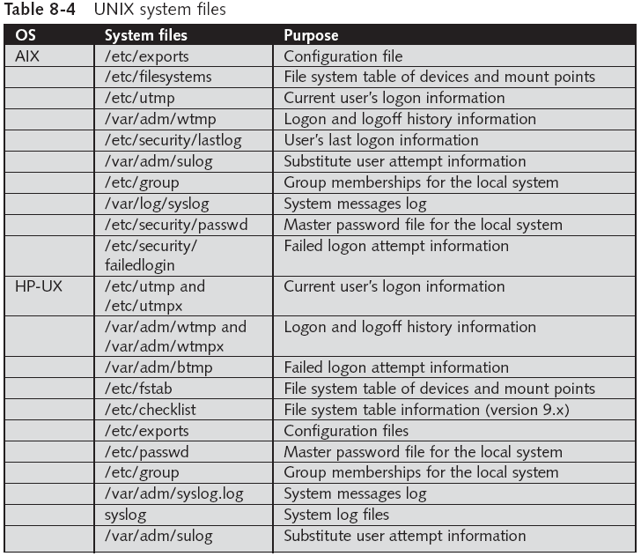

Slide 116
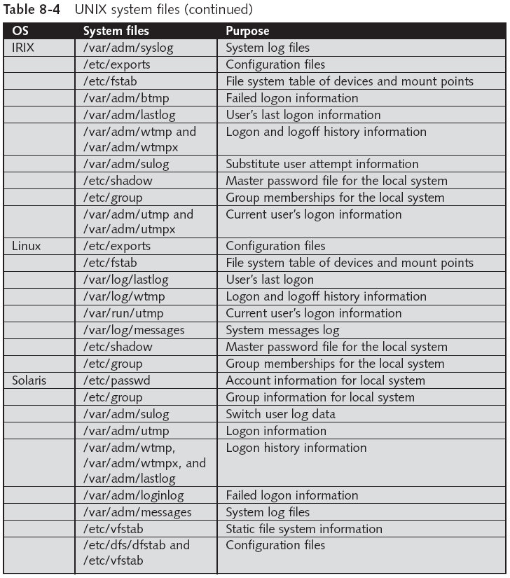

Slide 117
Examining UNIX and Linux Disk Structures and Boot Processes (continued)
Linux file systems
Second Extended File System (Ext2fs)
Ext3fs, journaling version of Ext2fs
Employs inodes
Contain information about each file or directory
Pointer to other inodes or blocks
Keep internal link count
Deleted inodes have count value 0

Slide 118
UNIX and Linux Overview
Everything is a file
Including disks, monitors, NIC, RAM
Files are objects with properties and methods
UNIX consists of four components
Boot block
Superblock
inode block
Data block

Slide 119
Boot Block and Superblock
Boot block
Block is a disk allocation unit of at least 512 bytes
Contains the bootstrap code
UNIX/Linux computer has only one boot block, located on the main hard disk
Superblock
Indicates disk geometry, available space, location of the first inode, and free inode list
Manages the file system
Multiple copies of the superblock are kept

Slide 120
inode Blocks and Data Blocks
inode blocks
First data after the superblock
An inode is assigned to every file allocation unit
Data blocks
Where directories and files are stored
This location is linked directly to inodes
Each sector contains 512 bytes
Each data block contains 1024-4096 bytes
Analogous to a cluster on a FAT or NTFS volume

Slide 121
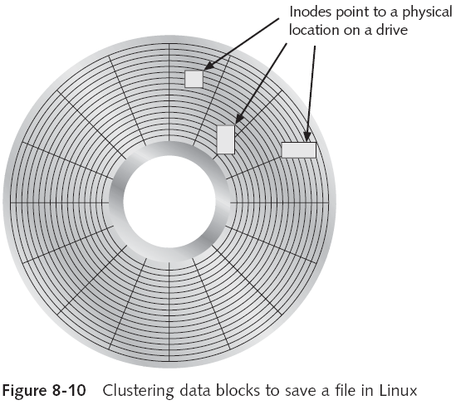
UNIX and Linux Overview (continued)

Slide 122
UNIX and Linux Overview (continued)
Bad block inode
Keeps track of disk’s bad sectors
Commands: badblocks, mke2fs, and e2fsck
Linux ls command displays information about files and directories
lowercase LS
For details, use the ls -l command
lowercase LS –L

Slide 123
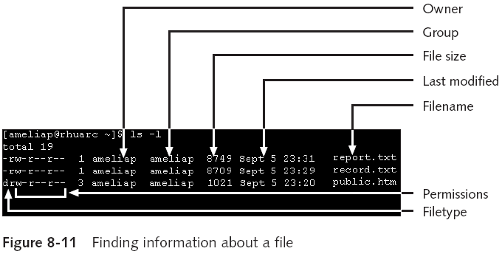
UNIX and Linux Overview (continued)

Slide 124
Continuation inode
Continuation inode
Provides information about a file or directory
Mode and file type, the quantity of links in the file or directory, the file or directory status flag
Sticky bit
Used in some old Unix versions to make programs load faster by keeping parts of the program in RAM
Used in modern Unix systems to prevent users from deleting files owned by others

Slide 125
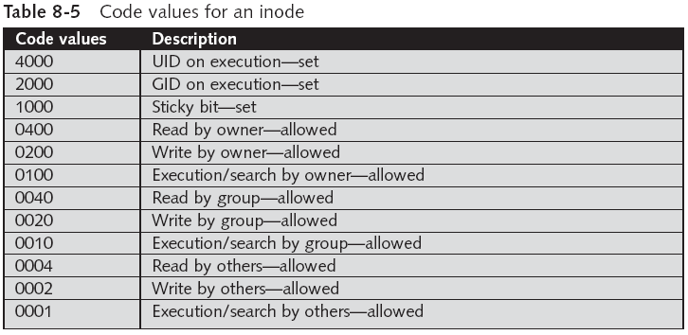
UNIX and Linux Overview (continued)

Slide 126
Understanding Inodes
Link data stored in data blocks (usually 1024 bytes)
Ext2fs and Ext3fs are improvements over Ext
Data recovery easier on Ext3fs than on Ext2fs
First inode has 13 pointers
Pointers 1 to 10 are direct pointers to data storage blocks
Pointer 11 is an indirect pointer
Pointer 12 is a double-indirect pointer
Pointer 13 is a triple-indirect pointer
Pointers 11-13 are needed for large files

Slide 127
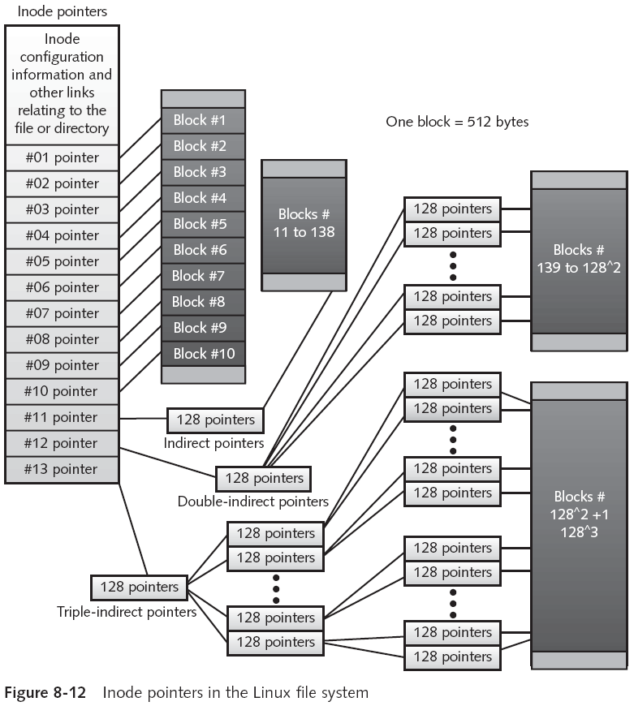

Slide 128
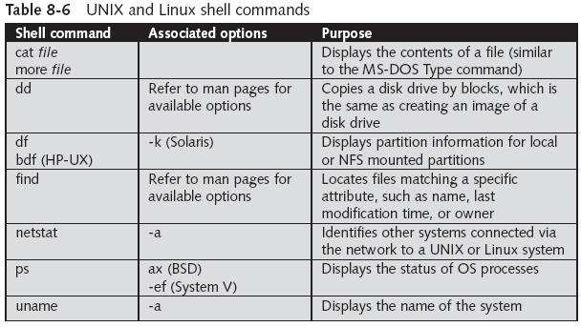
Understanding Inodes (continued)

Slide 129
Understanding UNIX and Linux Boot Processes
Instruction code in firmware is loaded into RAM
This is called memory-resident code because it is stored in ROM
Instruction code then:
Checks the hardware
Load the boot program
Boot program
Loads kernel
Transfers control to kernel
Kernel’s first task is to identify all devices

Slide 130
Understanding UNIX and Linux Boot Processes (continued)
Kernel
Boots system on single-user mode
Runs startup scripts
Changes to multiuser mode, then user logs on
Identifies root directory, swap, and dump files
Sets hostname and time zone
Runs consistency checks on the file system and mounts partitions
Starts services and sets up the NIC
Establishes user and system accounting and quotas

Slide 131
Understanding Linux Loader and GRUB
Linux Loader (LILO)
Old boot manager
Can start two or more OSs
Uses configuration file /etc/lilo.conf
Grand Unified Boot Loader (GRUB)
More powerful than LILO
As LILO, it resides on MBR
Command line or menu driven

Slide 132
Understanding UNIX and Linux Drives and Partition Schemes
Labeled as path starting at root (/) directory
Primary master disk (/dev/hda)
First partition is /dev/hda1
Second partition is /dev/hda2
Primary slave or secondary master or slave (/dev/hdb, /dev/hdc, or /dev/hdd)
First partition is /dev/hdb2
SCSI controllers
/dev/sda with first partition /dev/sda1
Linux treats SATA, USB, and FireWire devices the same way as SCSI devices

Slide 133
Examining UNIX and Linux Disk Structures
Most commercial computer forensics tools can analyze UNIX UFS and UFS2
And Linux Ext2, Ext3, ReiserFS, and Reiser4 file systems
Freeware tools include Sleuth Kit and its Web browser interface, Autopsy Browser
Foremost
A freeware carving tool that can read many image file formats
Configuration file: foremost.conf

Slide 134
Examining UNIX and Linux Disk Structures (continued)
Tarball
A data file containing one or more files or whole directories and their contents
Installing Sleuth Kit and Autopsy
Requires downloading and installing the most recent updates of these tools
Download the most current source code from www.sleuthkit.org
To run Sleuth Kit and Autopsy Browser, you need to have root privileges

Slide 135
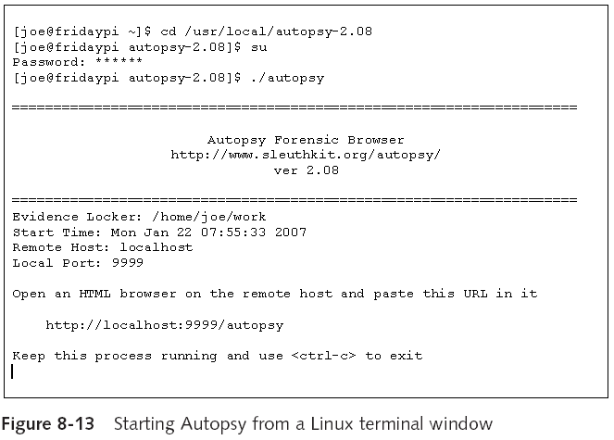
Examining UNIX and Linux Disk Structures (continued)

Slide 136
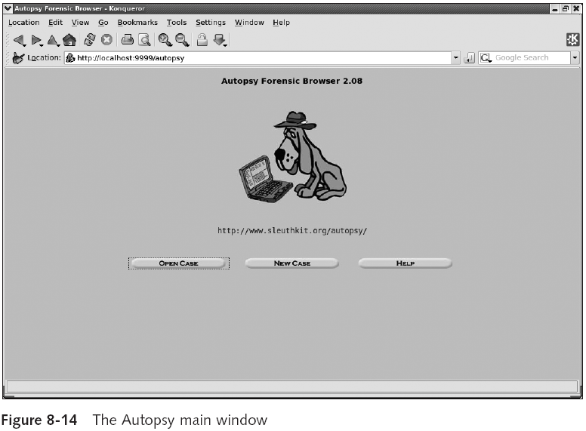

Slide 137
Examining UNIX and Linux Disk Structures (continued)
Examining a case with Sleuth Kit and Autopsy
Use Sleuth Kit and Autopsy Browser to analyze a Linux Ext2 and Ext3 file system
See Figures 8-15 through 8-18

Slide 138
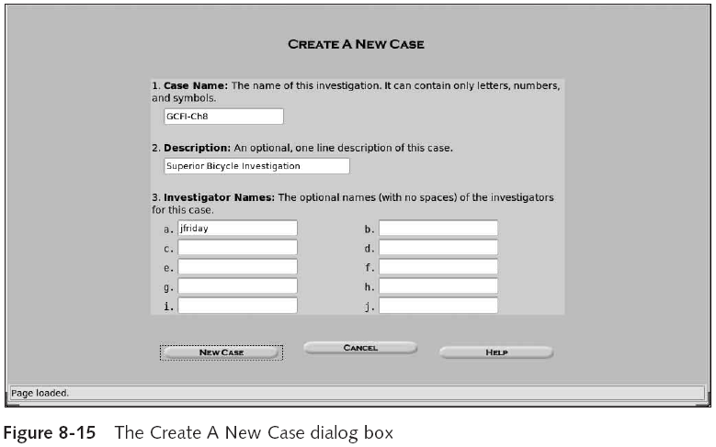
Examining UNIX and Linux Disk Structures (continued)

Slide 139

Examining UNIX and Linux Disk Structures (continued)

Slide 140

Examining UNIX and Linux Disk Structures (continued)

Slide 141


Slide 142
Examining UNIX and Linux Disk Structures (continued)
Examining a case with Sleuth Kit and Autopsy (continued)
Use the File Activity Time Lines function
Identifies what files were active at a specific time
See Figures 8-19 and 8-20

Slide 143

Examining UNIX and Linux Disk Structures (continued)

Slide 144

Examining UNIX and Linux Disk Structures (continued)

Slide 145
Understanding Other Disk Structures

Slide 146
Understanding Other Disk Structures
CDs and DVDs
SCSI disks
IDE/EIDE disks
SATA drives

Slide 147
Examining CD Data Structures
Laser burns flat areas (lands)
Lower areas are called pits
Transitions
From lands to pits have binary value 1 (on)
No transition has binary value 0 (off)
International Organization of Standards (ISO)
ISO 9660 for CD, CD-R and CD-RW
ISO 13346 for DVDs

Slide 148


Slide 149

Examining CD Data Structures (continued)

Slide 150
Examining CD Data Structures (continued)
99 tracks available in the lead-in area, for the table of contents
Program area also has 99 tracks available for data

Slide 151
Examining CD Data Structures (continued)
Frame is the unit storage
Contains 24 17-bits symbols
Frames are combined into blocks
Blocks are combined into sectors
2352 bytes for CD-DA (music CDs)
2048 bytes for CD (data CDs)
Constant Linear Velocity (< 12X)
Constant Angular Velocity (>= 12X)

Slide 152
Examining CD Data Structures (continued)
DVD disk file structures use a Universal Disk Format (UDF)
Called Micro-UDF (M-UDF)
For backward compatibility, some DVDs have integrated ISO 9660
To allow compatibility with current OSs

Slide 153
Examining SCSI Disks
Small Computer System Interface (SCSI)
Provides a common bus communication device
During investigation
Check if the device is internal or external
Check if card, cables, adapters, terminators, and drivers are available
Advance SCSI Programming Interface (ASPI)
Provides several software drivers for communication between the OS and SCSI component

Slide 154
Examining SCSI Disks (continued)
Might need to adjust settings
Port numbers and terminators
Newer SCSI devices typically use an integrated self-terminator
One problem with older SCSI drives is identifying which jumper group terminates and assigns a port number

Slide 155
Examining IDE/EIDE and SATA Devices
Most forensic disk examinations involve EIDE and SATA drives
SATA drives from ATA-33 to ATA-133
Standard 40-pin ribbon or shielded cable
40-pin/80-wire cable for ATA-66, 100, and 133
CMOS identifies proper disk settings using:
Logical block addressing (LBA)
Enhanced CHS configurations
Can be a problem during an investigation

Slide 156
Examining IDE/EIDE and SATA Devices (continued)
Solutions
Use disk imaging tools
Use an old PC
Cards and adapters
ISA SCSI card
A-Card IDE adapter
SCSI-to-IDE adapter
EISA FireWire card
FireWire-to-EIDE adapter

Slide 157
Examining IDE/EIDE and SATA Devices (continued)
Examining the IDE host protected area
ATAPI-5 AT introduced in 1998 reserved and protected areas on IDE devices
Protected Area Run Time Interface Extension Service (PARTIES)
Data stored by diagnostic and restore programs
Tools
X-Ways Replica
HPA is also referred to as a BIOS Engineering Extension Record (BEER) data structure

Slide 158
Examining IDE/EIDE and SATA Devices (continued)
Exploring hidden partitions
Suspects try to conceal evidence by hiding disk partitions
Norton Disk Edit can change the disk partition table
Leaving no indication that the deactivated partition exists in Windows Explorer
Use imaging tools that can access un-partitioned areas of a drive

